Slide 1
REPORT

Slide 2
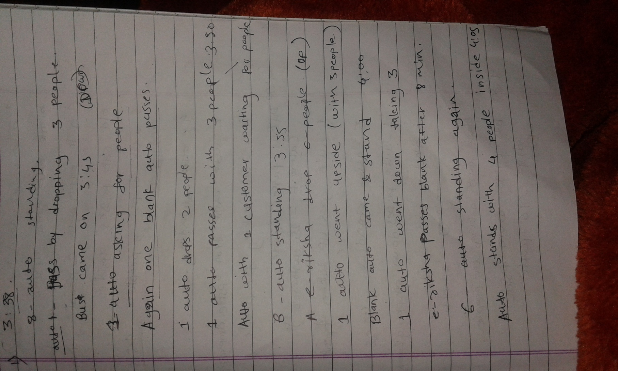
Survey in front of VT

Slide 3
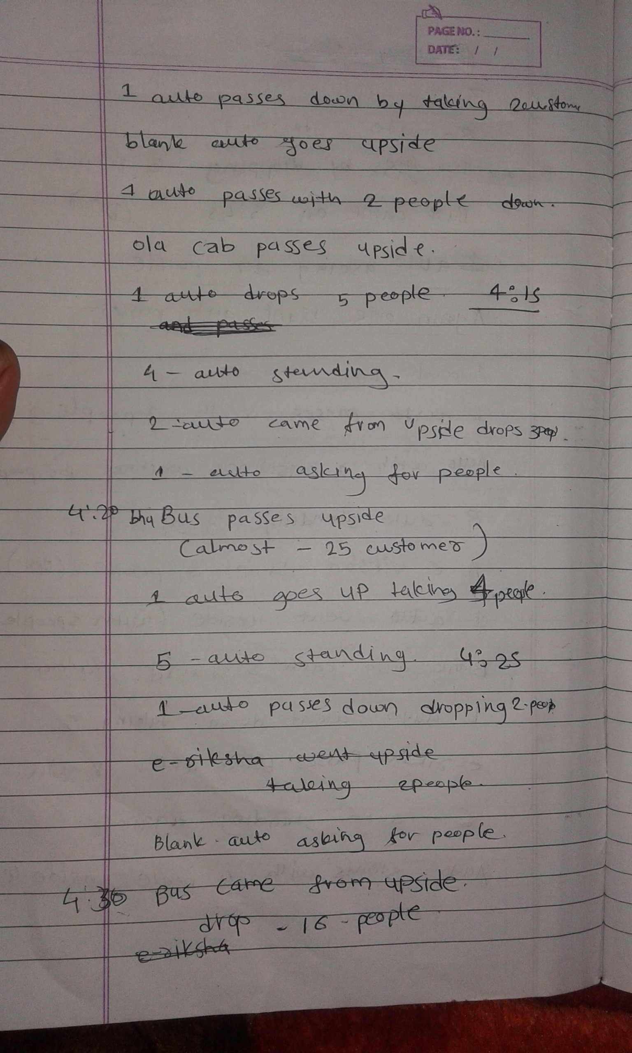

Slide 4
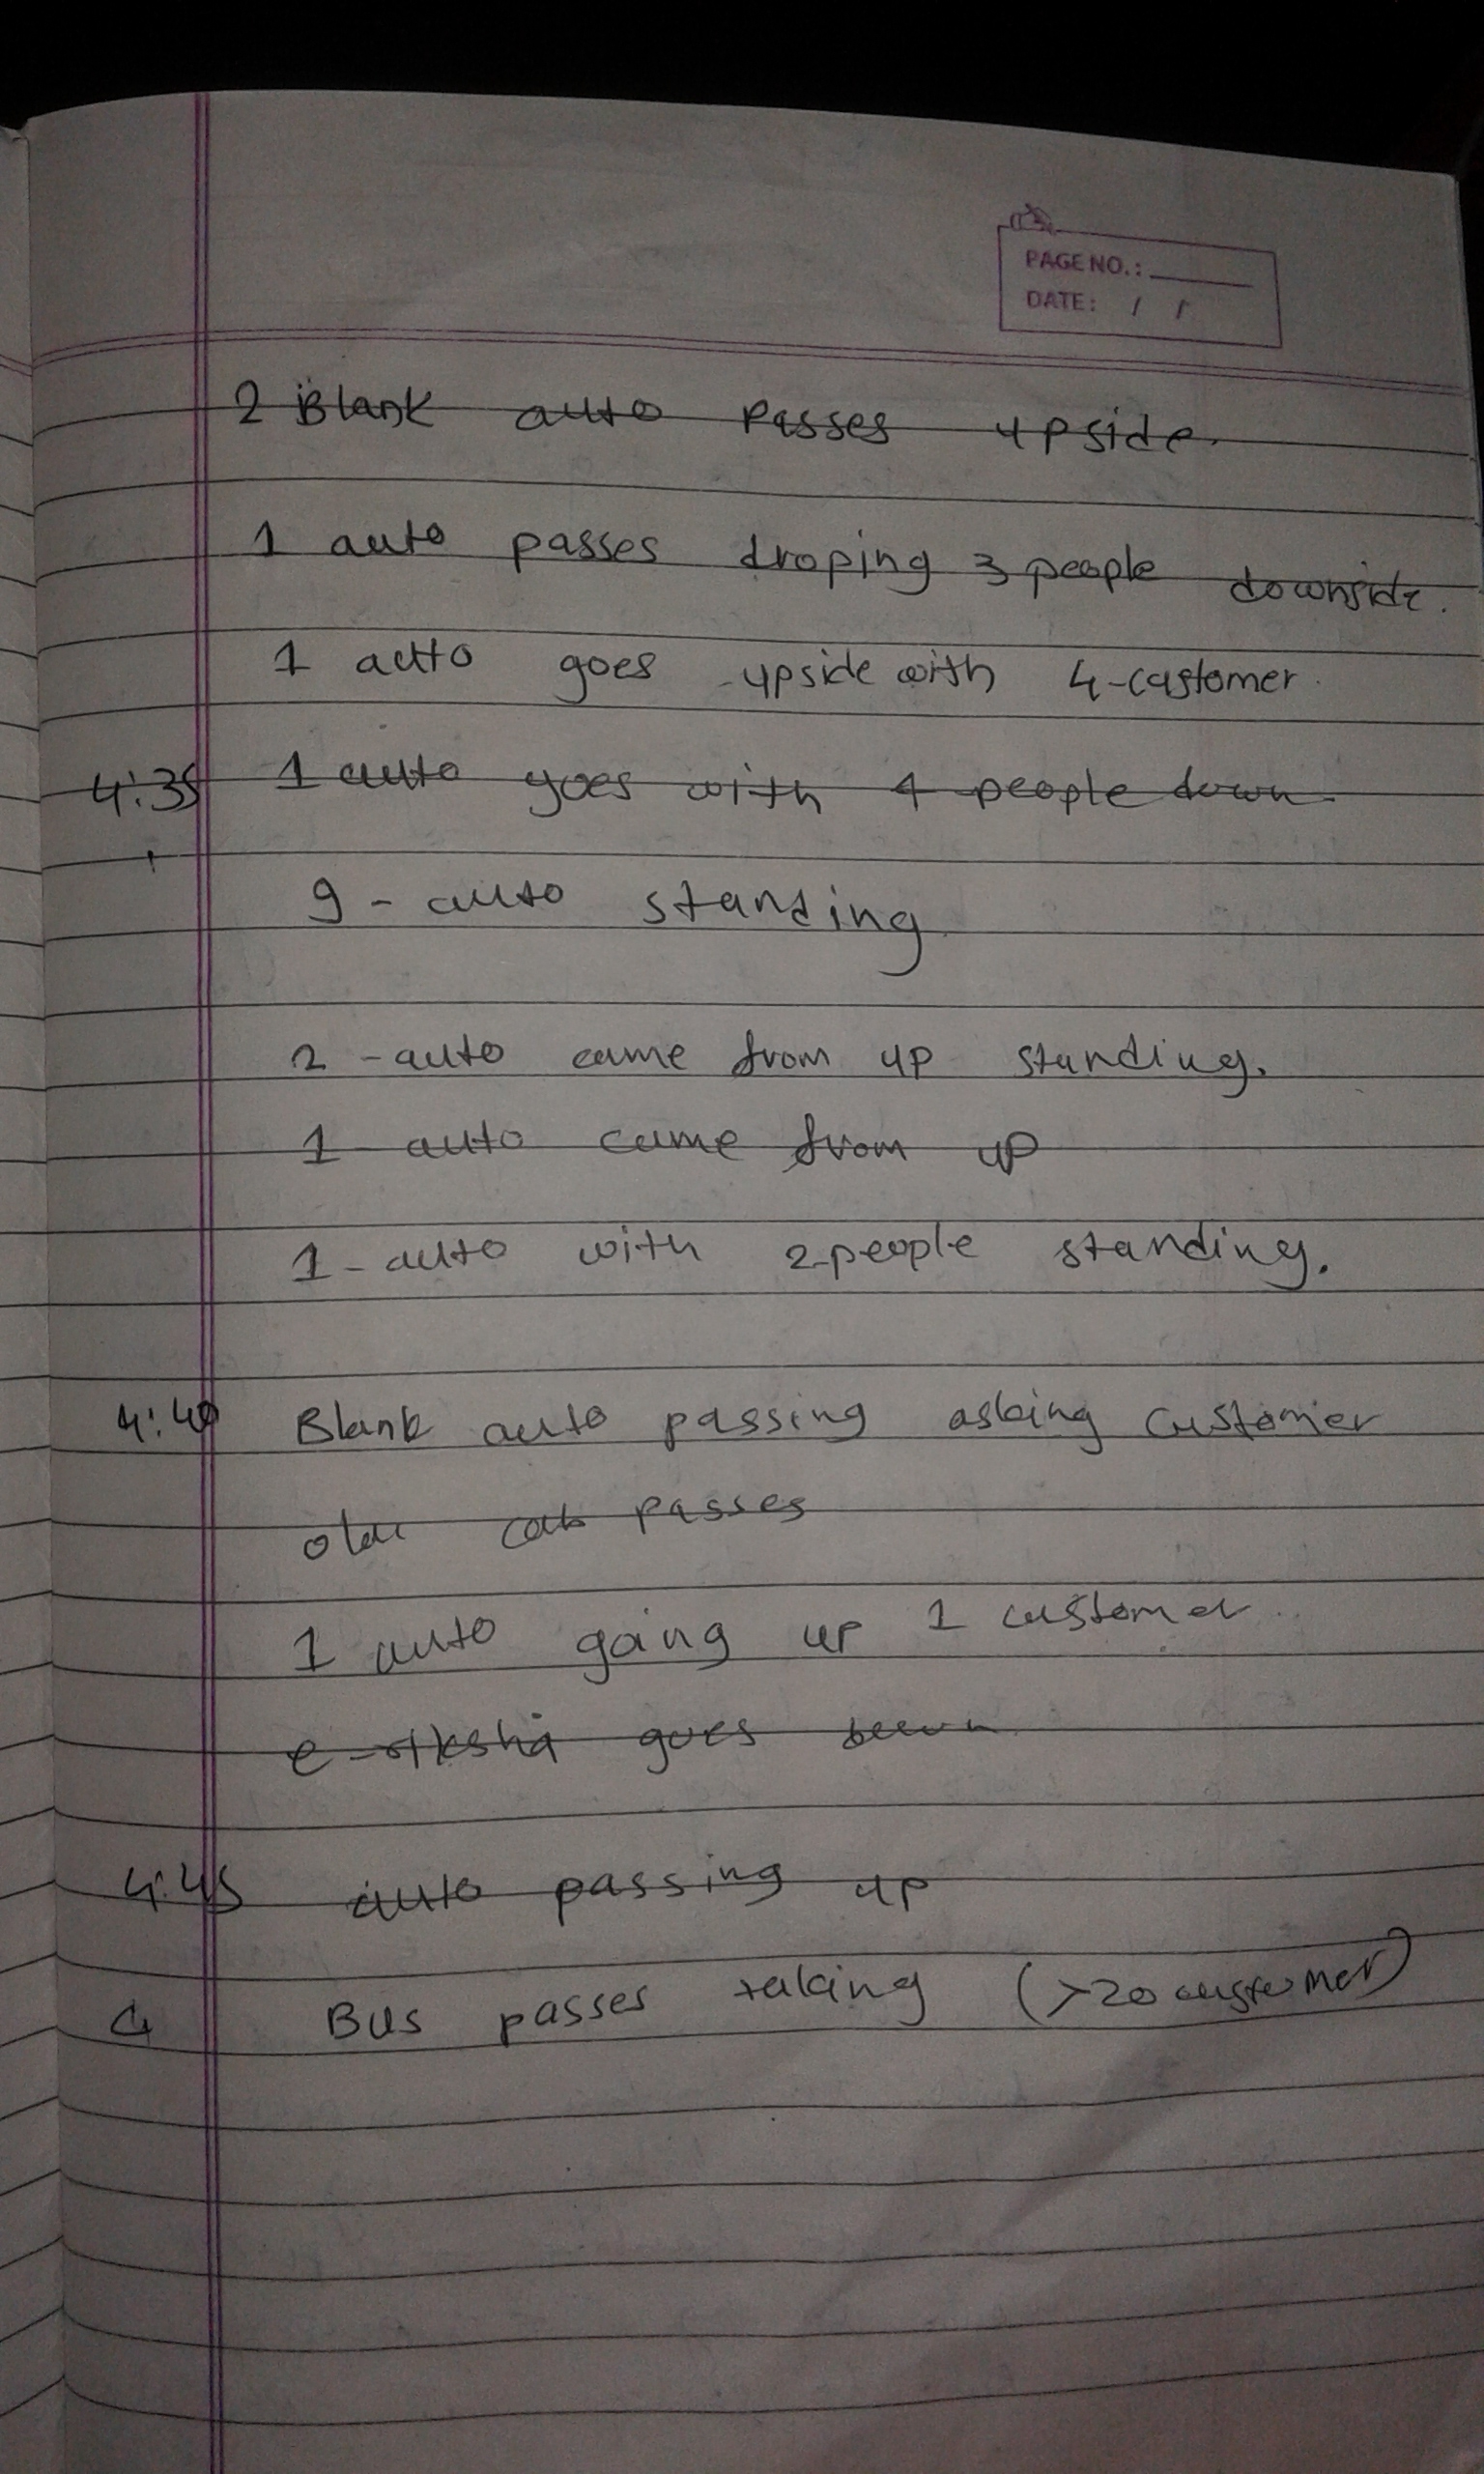

Slide 5
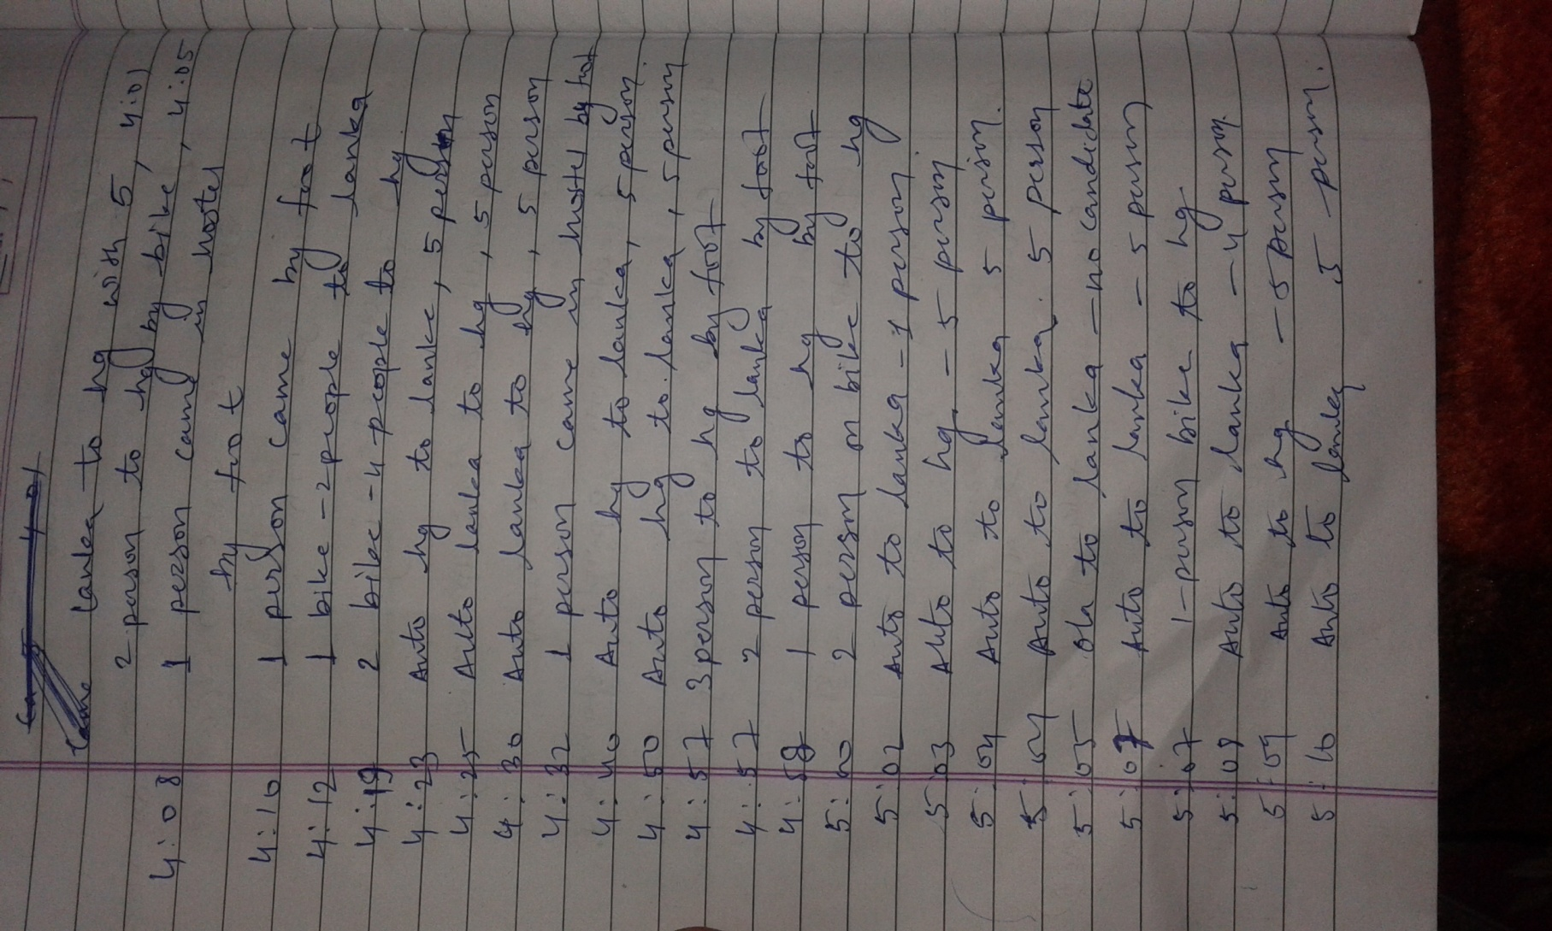
Survey behind VT

Slide 6
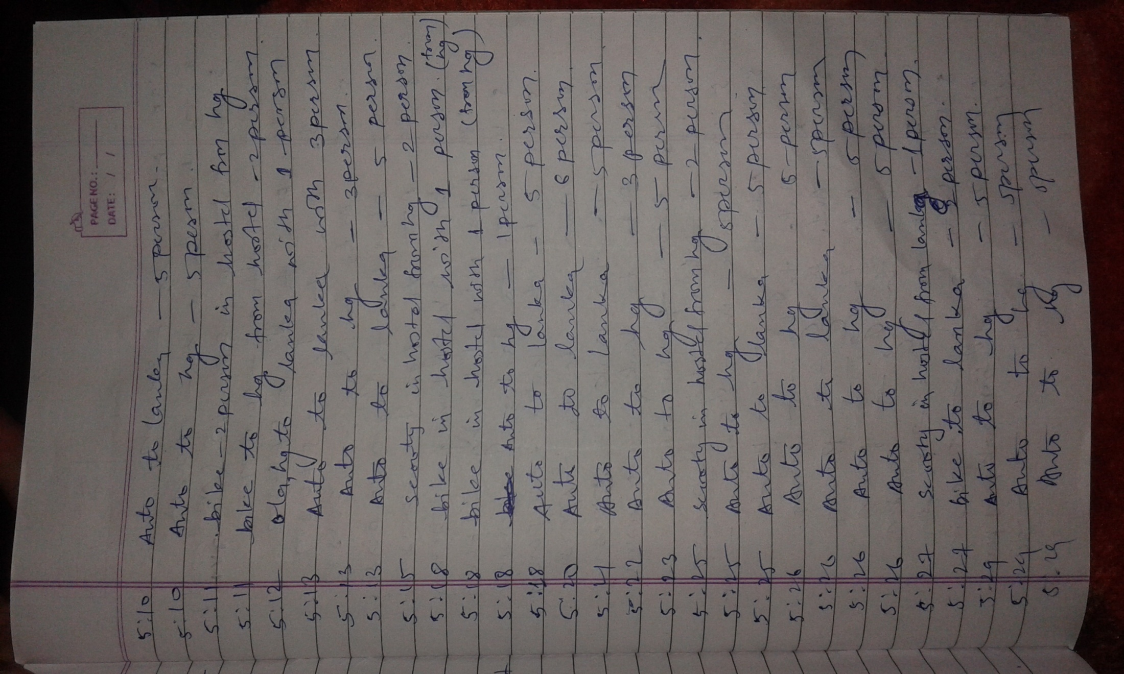

Slide 7
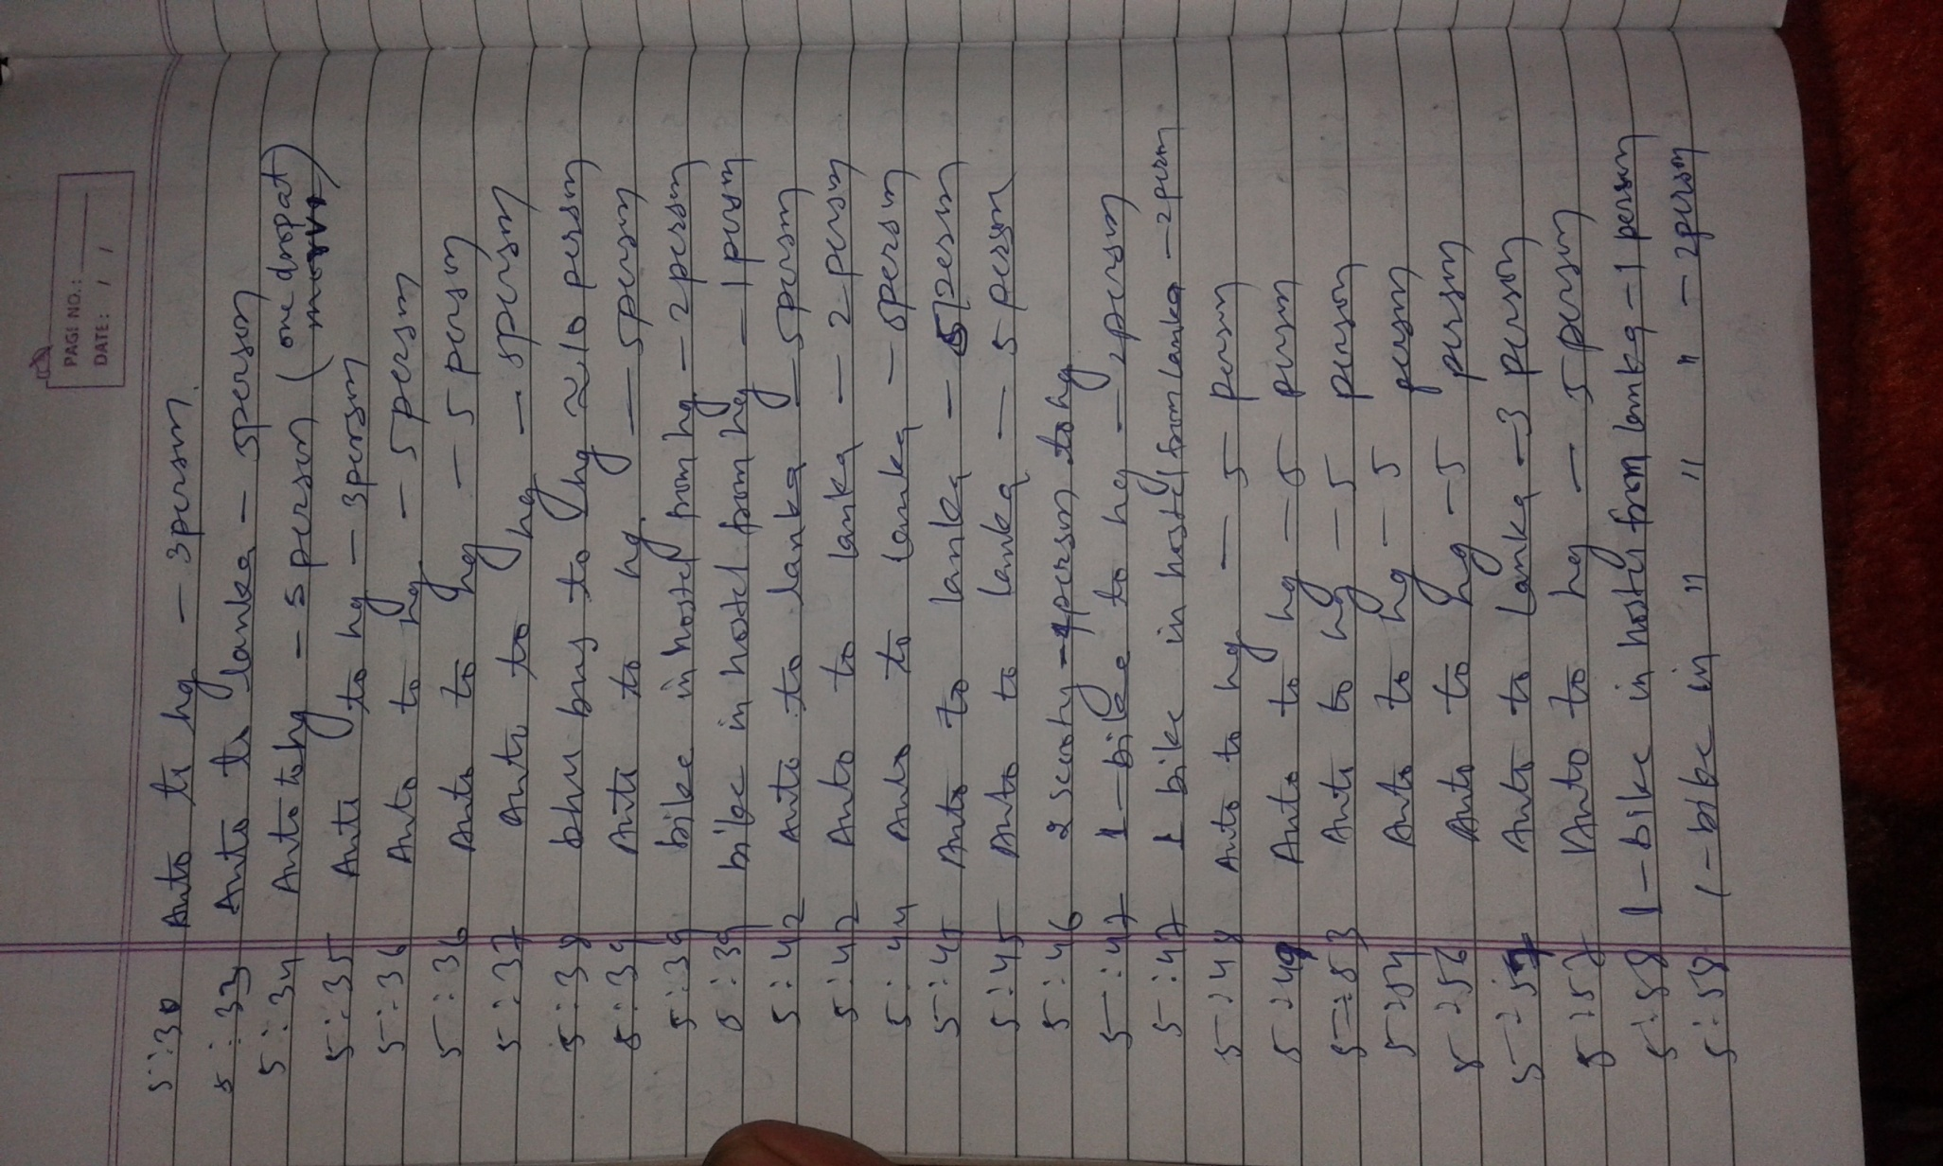

Slide 8
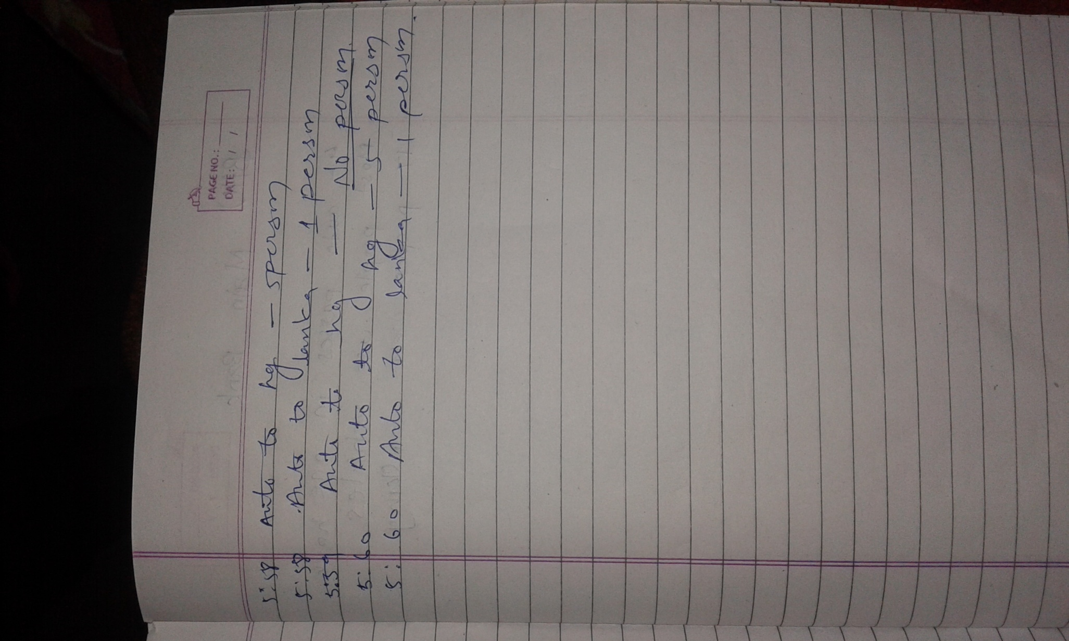

Slide 9
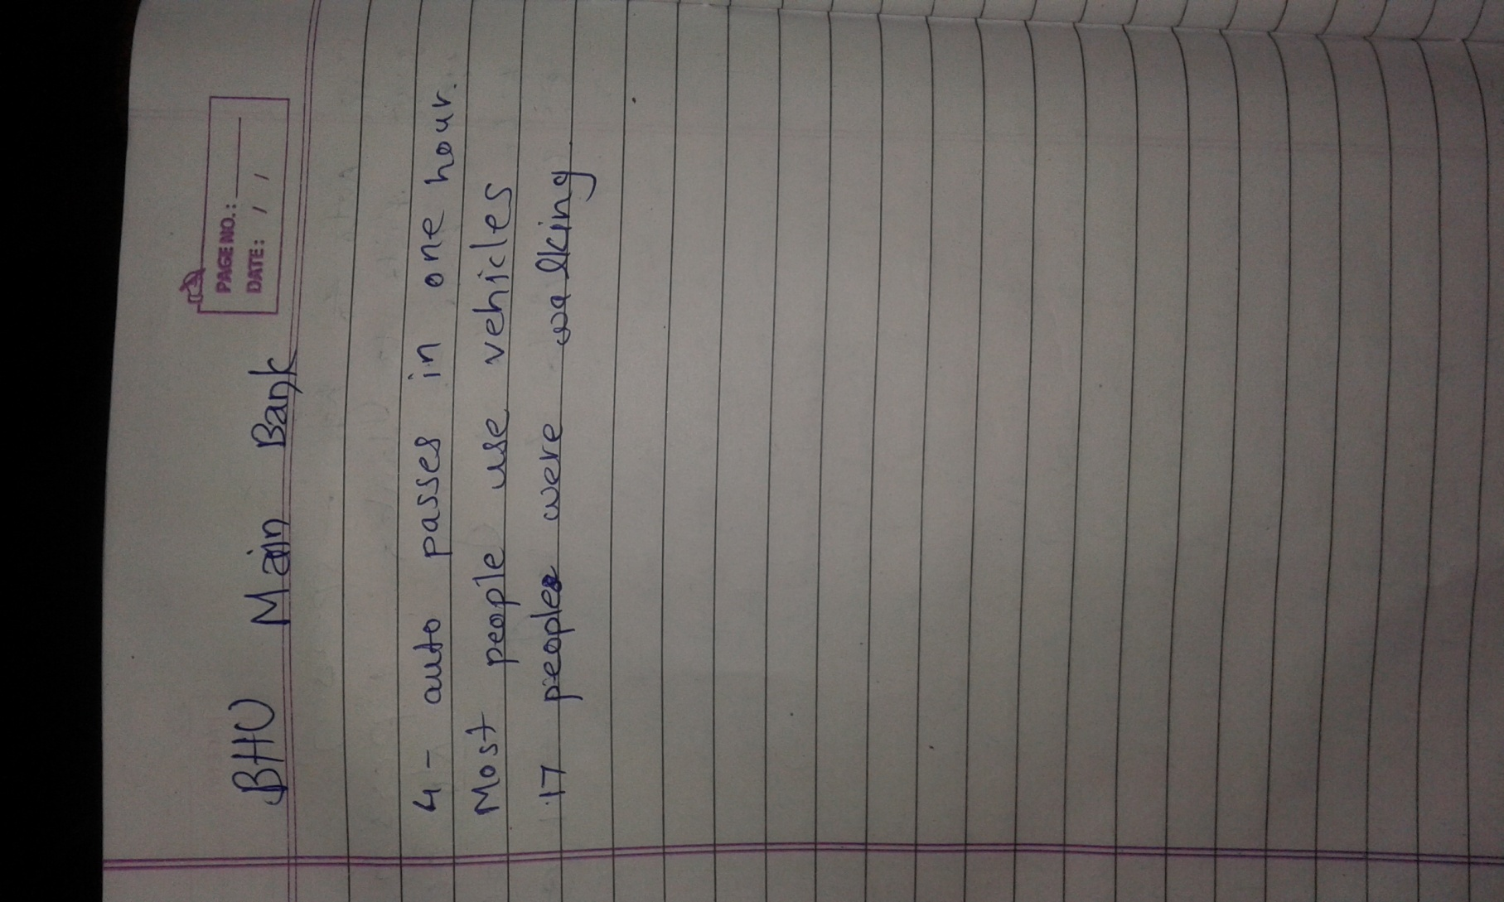
Bhu main bank

Slide 10
Vishwakarma, Vivekanand Hostel
No auto comes to pick students
Student goes either on personal vehicles or by walking
One auto came in two hour to drop a student

Slide 11
Dalmia Hostel and ahead of health center
Students wait on corner for auto
They have to wait too long because most of the autos go full
Either they go to VT or use bicycle

Slide 12
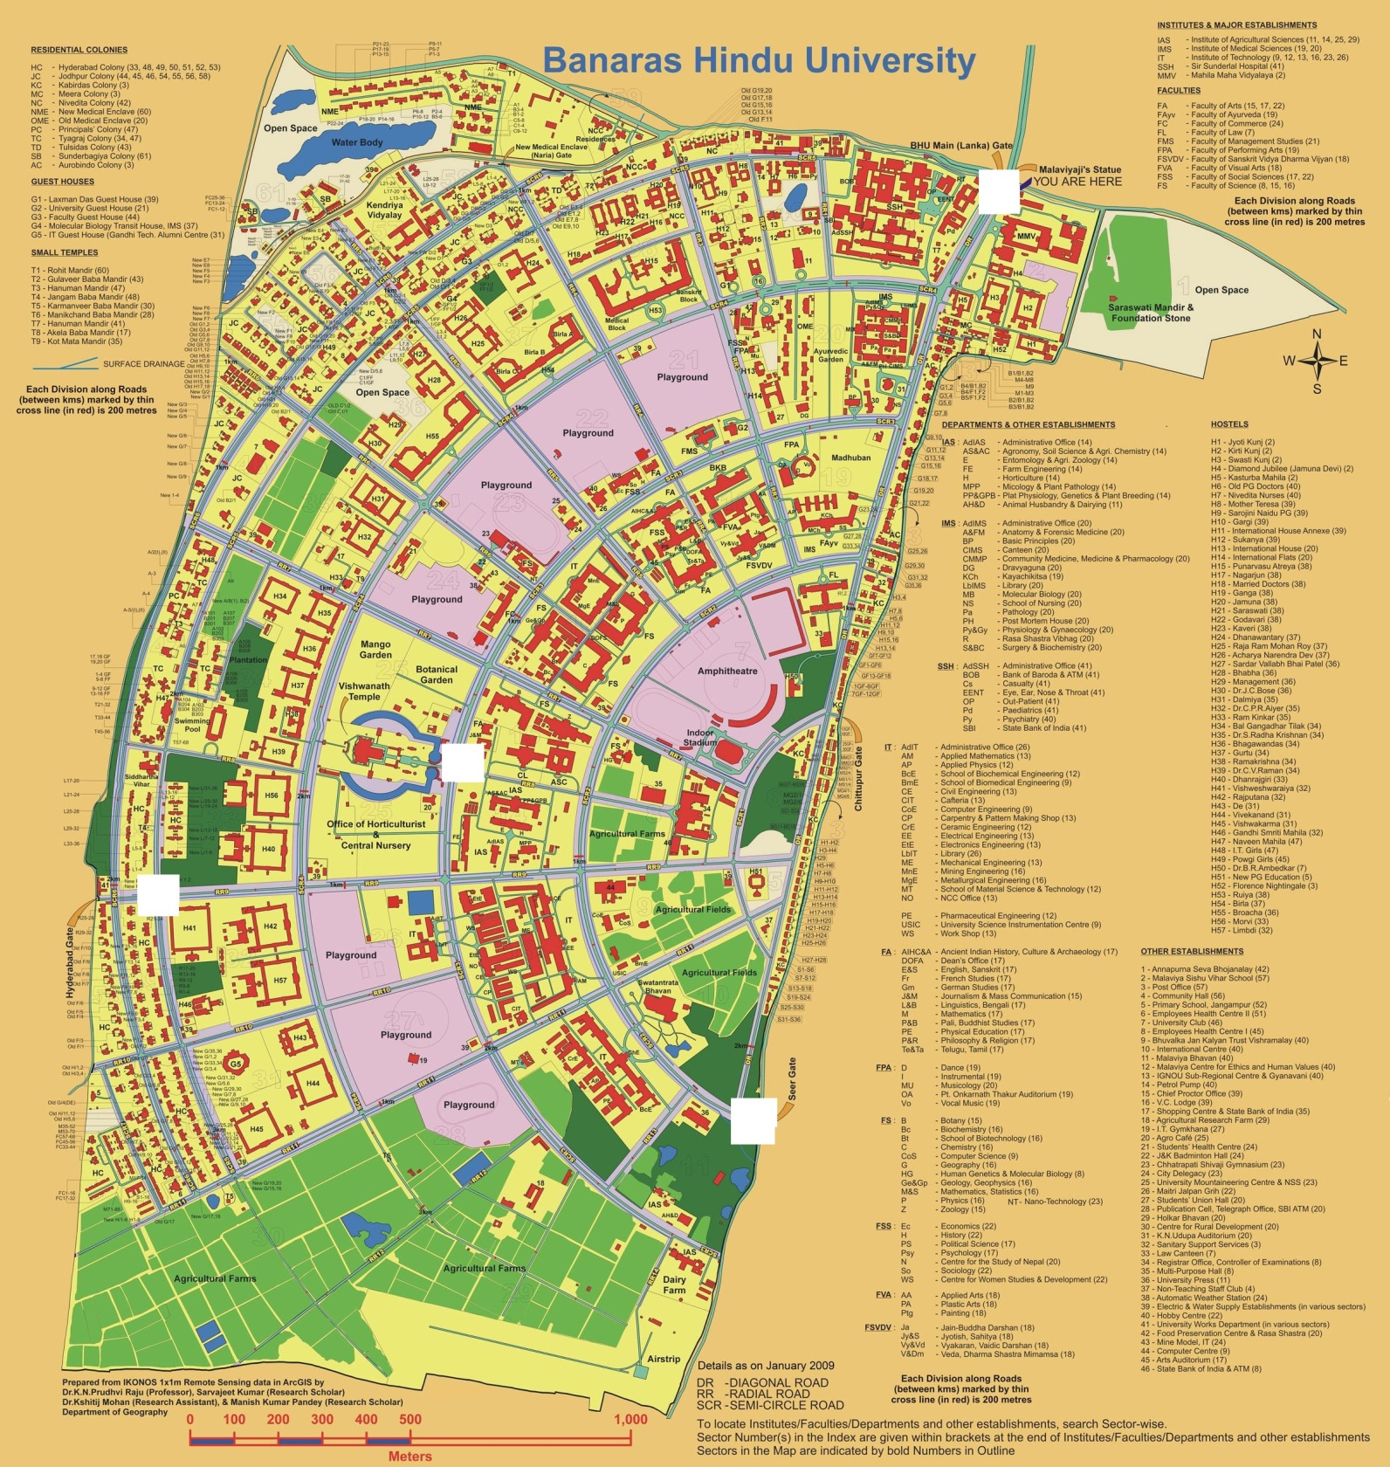

Slide 13
Benefits
Customer
Timing
Reduced effort
Reliable
Auto drivers
Timing
Systematic way
Benefit on occasion
efficiency
Service provider
App downloads
Google Advertisement

